Slide 1
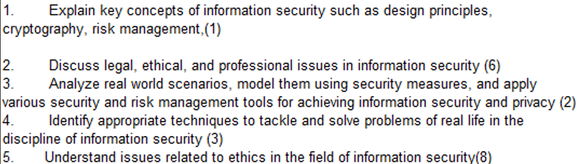
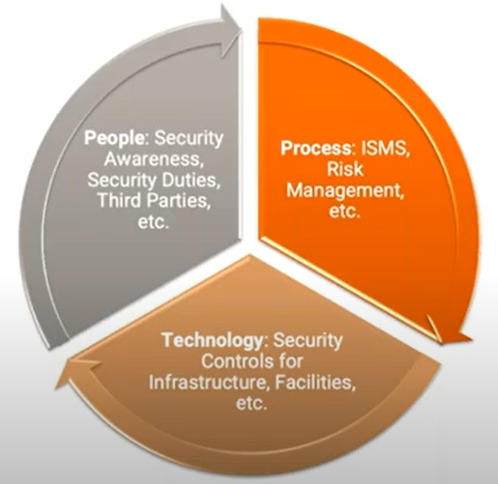
CS 3002 Information Security
Fall 2024
Week # 4 – Lecture # 10, 11, 12
10th – 12th September 2024
Dr. Aqsa Aslam

Slide 2
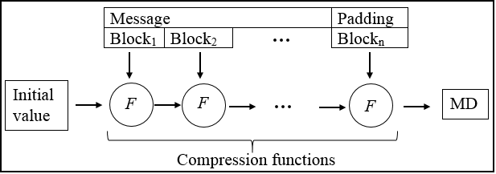
Merkle-Damgård paradigm
The Merkle-Damgård construction is a scheme to design collision-resistant cryptographic hash functions.
Many popular hash functions like MD5, SHA-1, and SHA-2 have been designed using Merkle Damgard construction
Structure:
Padding: Extend the input message to a multiple of a block size by appending a '1' bit, followed by '0' bits, and the message length.
Initialization: Start with a fixed-size initial value (IV) as the initial hash value.
Compression Function: Process the message in fixed-size blocks using a compression function that updates the hash value with each block

Slide 3
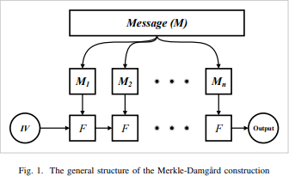
Various constructions of Hash Functions
Figure 1 shows the general structure of the Merkle- Damgard construction:
a message (M) is divided into blocks and processed
sequentially using a compression function (F).
This structure requires initial values (IV) that are used to process the first block.
The output of each block is used to process the next
block.
The final output is produced after processing the last block of the message.
MD4 and MD5 formed the base for the following hash functions that come after, which have the same Merkle Damgard construction. We list examples of these functions as follows: SHA-0, SHA-1, SHA-2 (SHA-224, SHA-256, SHA-384, and SHA-512), RIPEMD 160.

Slide 4
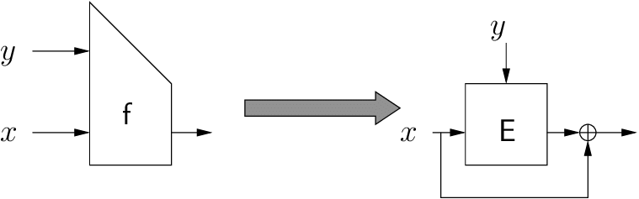
Compression. func. from a block cipher
E: K× {0,1}^{n} ⟶ {0,1}^{n} a block cipher
The Davies-Meyer construction uses a block cipher to build the compression function for the hash algorithm.
The Davies-Meyer compression function: h(H, m) = E(m, H)⨁H
A key from the set K, which is {0,1} ^{n} (n-bit length).
A message (or plaintext) also from {0,1} ^{n}.
The output is also an n-bit value ({0,1} ^{n}).
H is the current hash state.
m is the message block.
E(m, H) denotes the encryption of the current hash state H using the message block m as the key.
⊕ (XOR) is used to combine the encrypted output with the current hash state.
m_{i}
>
E
⨁
H_{i}
The message block m_{i} is used as the key to the block cipher E.
The current hash state H_{i} is fed into the block cipher E as the message.
The block cipher produces an output which is XORed with the hash state H_{i}.
This XOR operation results in the new hash state.
Notes:
All SHA use Davies-Meyer
Can we build compression function from block cipher ? Yes
Given message block m and chaining variable H
Message block is used as a Key
This theorem say that this function is as collision resistant as possible

Slide 5
Compression. func. from a block cipher
Thm: Suppose E is an ideal cipher (collection of |K| random perms.).
Finding a collision h(H,m)=h(H’,m’) takes O(2^{n/2}) evaluations of (E,D).
The security implication (theorem) states that:
If the block cipher E used in the Davies-Meyer construction behaves like an ideal cipher (meaning it acts in an unpredictable and random manner), then finding two different inputs that result in the same output (a collision) is very difficult.
To find a collision, where two different pairs (H, m) and (H', m') produce the same output (h(H, m) = h(H', m’)),
you would need to try about 2^{n/2} different combinations.
For a hash function with an output size of n bits (like 256 bits for SHA-256), this means you would need
around 2 ^{256 / 2} = 2 ¹²⁸ tries to find a collision.
Best possible !!
Notes:
All SHA use Davies-MeyerFor a hash function with an output size of n bits (like 256 bits for SHA-256), this means you would need around 2256/2=21282^{256/2} = 2^{128}2256/2=2128 tries to find a collision.
Can we build compression function from block cipher ? Yes
Given message block m and chaining variable H
Message block is used as a Key
This theorem say that this function is as collision resistant as possible

Slide 6
Case study: SHA-256
Merkle-Damgard function
Davies-Meyer compression function
Block cipher: SHACAL-2
m_{i}
SHACAL-2 Block Cipher: Processes the current message block (m_{i}) and the previous hash state (H_{i-1}) to produce the new hash state (H_{i}). In the Davies-Meyer construction, this involves encrypting the previous hash state with the message block and then XORing the output with the previous hash state.
512-bit key
>
SHACAL-2
H_{i}
H_{i-1}
256-bit block
256-bit block
Notes:
512 bit key is taken from the message

Slide 7
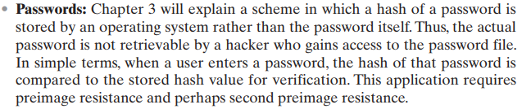
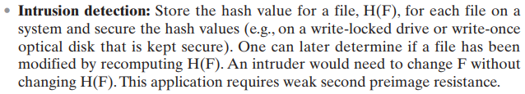

Slide 8
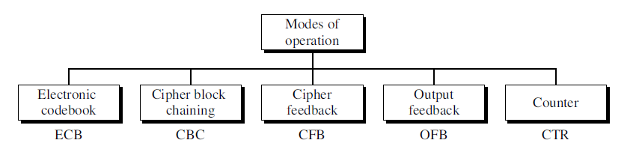
Block Cipher Mode of Operation

Slide 9
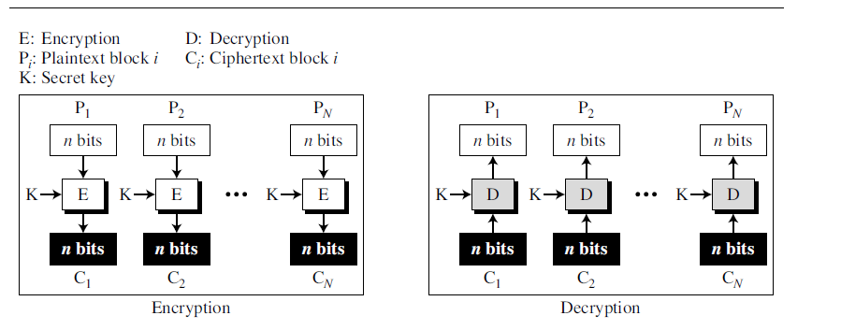
Electronic Codebook (ECB) mode
Simplest method: divide a message into blocks and encrypt each one
Advantage: fast access to single blocks
*image source = wiki (also for several following images)

Slide 10


Electronic Codebook (ECB) mode
Disadvantage: Too simple, too dangerous; does not satisfy the requirements
Does not hide data patterns well and doesn't provide serious message confidentiality
Not recommended for use in cryptographic protocols at all.
Identical blocks are encrypted to the same cipher block and can be identified by an attacker i.e. if m₁=m₂ then c₁=c₂
The message structure can be identified
If the attacker knows, what context the plaintext has, parts of message can be manipulated
ECB is not semantically secure for messages that contain more than one block.
Original Image
Encrypted using ECB mode
Notes:
Larger the key, more secure, but more slow

Slide 11
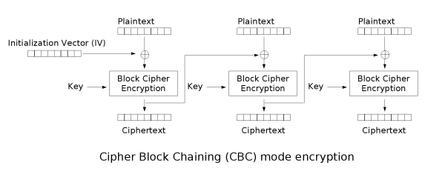
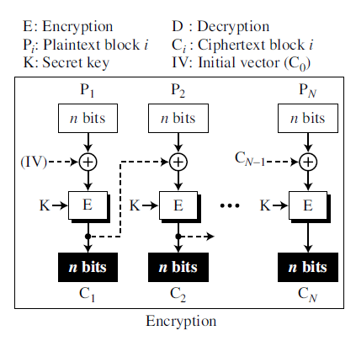
Cipher Block Chaining (CBC) mode
Invented by IBM in 1976
Each block of plaintext is XORed with the previous ciphertext block before being encrypted
Each ciphertext block depends on all plaintext blocks processed up to that point
For Uniqueness, an initialization vector (IV) must be used in the first block.
Encryption
Mathematical Formula
Notes:
Larger the key, more secure, but more slow

Slide 12
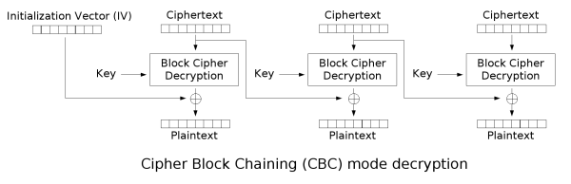
Cipher Block Chaining (CBC) mode
For each message to be encoded, a new IV should be used
A random IV of the same block size as the cipher is chosen.
The IV is used to initialize the encryption process and ensure that identical plaintext blocks will not result in identical ciphertext blocks across different sessions.
Usage of the same IV for all messages would cause some problems:
Differences in similar messages can be found by an attacker
Old messages can be sent by an attacker at a later time
Chosen plaintext can be applied as an attack
Decryption
Mathematical Formula
Notes:
Larger the key, more secure, but more slow

Slide 13

Cipher Block Chaining (CBC) mode
Drawback(s)
Encryption is sequential (cannot be parallelized).
A one-bit change in a plaintext or IV affects all following ciphertext blocks.
For Decryption Incorrect IV causes only the first block of plaintext to be corrupt
Plaintext block can be recovered from two adjacent blocks of ciphertext
Decryption cannot be parallelized
one-bit change to the ciphertext causes complete corruption of the corresponding block of plaintext
rest of the blocks remain intact.
Example: Common in file encryption where consistent block sizes are used.
Original Image
Encrypted using CBC mode
Notes:
Larger the key, more secure, but more slow

Slide 14
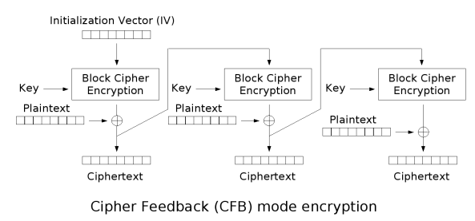

Cipher Feedback (CFB) mode
Close relative of CBC, makes a block cipher into a self-synchronizing stream cipher
Self-synchronizing: Corrects itself if synchronization is lost, resuming after a few segments
Encryption
Mathematical Formula
Notes:
Larger the key, more secure, but more slow

Slide 15
Cipher Feedback (CFB) mode
Close relative of CBC, makes a block cipher into a self-synchronizing stream cipher
Turns a block cipher into a stream cipher.
Encrypts the IV, XORs with plaintext to produce ciphertext, and uses the ciphertext as the next input.
Advantage: Can encrypt smaller units (bytes or bits), and synchronization can fix itself if interrupted.
Encryption
Example: Ideal for streaming data or applications needing real-time encryption.
Mathematical Formula
Notes:
Larger the key, more secure, but more slow

Slide 16
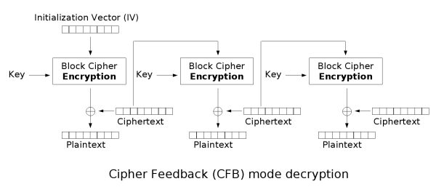

Cipher Feedback (CFB) mode
CFB decryption is almost identical to CBC encryption performed in reverse
Decryption
Notes:
Larger the key, more secure, but more slow

Slide 17
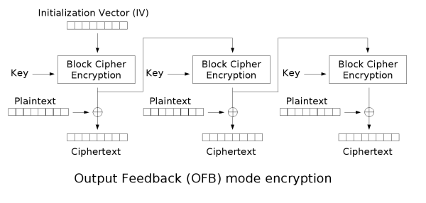
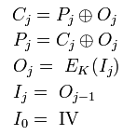
Output Feedback (OFB) mode
Makes a block cipher into a synchronous stream cipher
Similar to CFB, but instead of using the ciphertext as feedback, it continuously encrypts the previous output.
OFB mode is like creating a series of keys from an initial block and using these keys to encrypt data.
Each encryption step depends on the previous one, making it secure and efficient for stream-like data.
Encryption
Example: OFB mode is ideal for secure messaging apps as it allows on-the-fly encryption, processes message blocks independently, and prevents error propagation between blocks.
Mathematical Formula

Slide 18
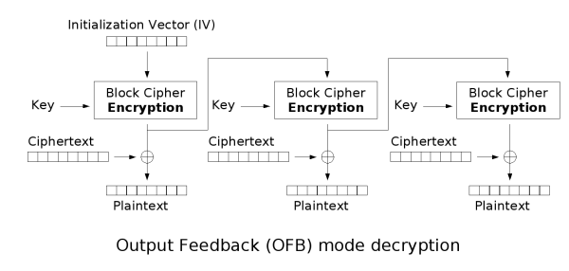
Output Feedback (OFB) mode
Because of the symmetry of the XOR operation, encryption and decryption are exactly the same:
Decryption
Notes:
Larger the key, more secure, but more slow

Slide 19
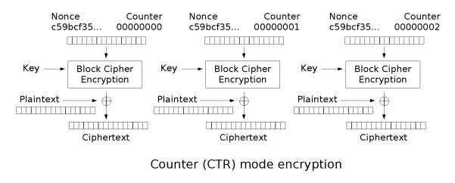
Counter Mode (CTR) mode
Like OFB, counter mode turns a block cipher into a stream cipher
The counter can be any function which produces a sequence which is guaranteed not to repeat for a long time
CTR mode is widely accepted and CBC, CTR modes are recommended by Niels Ferguson and Bruce Schneier
CTR mode is well suited to operate on a multi-processor machine where blocks can be encrypted in parallel
Example: Best for high-performance applications and parallel processing, like network encryption.
Notes:
Like OFB, counter mode turns a block cipher into a stream cipher. The counter can be any function which produces a sequence which is guaranteed not to repeat for a long time. CTR mode is widely accepted and CBC, CTR modes are recommended by Niels Ferguson and Bruce Schneier.
CTR mode is well suited to operation on a multi-processor machine where blocks can be encrypted in parallel.

Slide 20
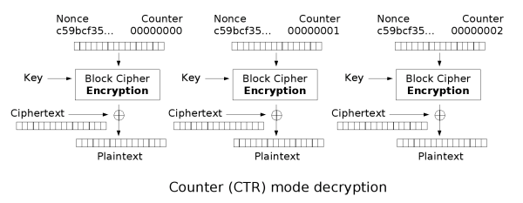
Counter Mode (CTR) mode
Notes:
Larger the key, more secure, but more slow

Slide 21
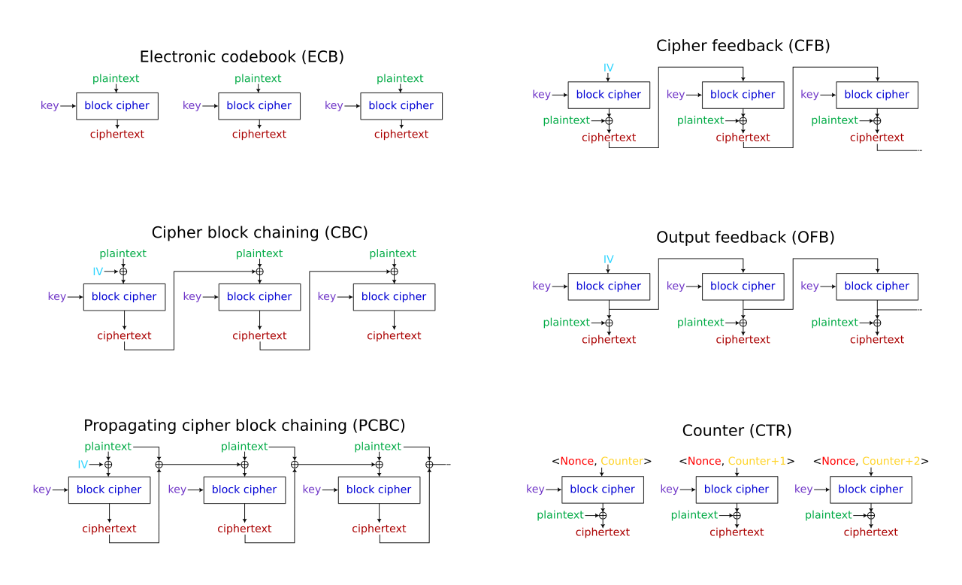
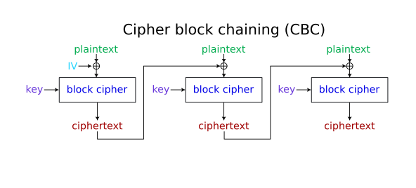
Encryption mode: Summary
ECB is the simplest but least secure due to its lack of chaining and pattern visibility.
OFB: Similar to CFB in streaming capability and error confinement, with a focus on feedback loops.
CBC improves security by introducing dependency between blocks but is not suitable for parallel processing and error propagation can be an issue.
CTR: Offers high performance and parallelization, suitable for both block and streaming encryption without the need for padding.
CFB: Suitable for streaming and provides error confinement, but not parallelizable.

Slide 22
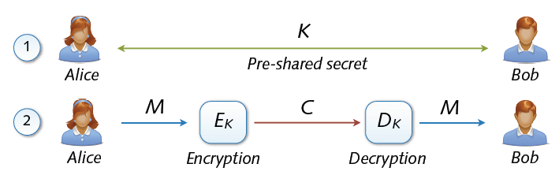
Key Exchange
Symmetric cryptosystems secure and efficient, but ...
Precondition: secure exchange of keys in advance
Paradox situation at a first glance
secure communication depends on secure key exchange
which itself is a process that needs to be secure.

Slide 23
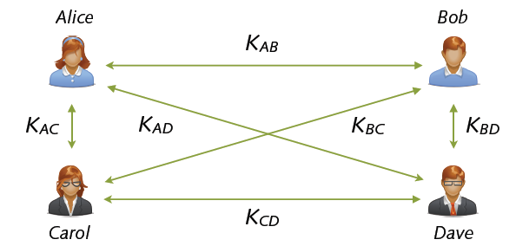
Multi-party Key Exchange
Involved multi-party key exchange with symmetric keys
Quadratic growths: n parties → (n2 - n) / 2 keys
In a multi-party system involving n parties, the number of unique symmetric keys required grows quadratically.
Example: For 10 parties, this results in 45 unique keys needed, making management and secure distribution increasingly complex.
Problem rooted in symmetry (shared keys). Alternatives?

Slide 24
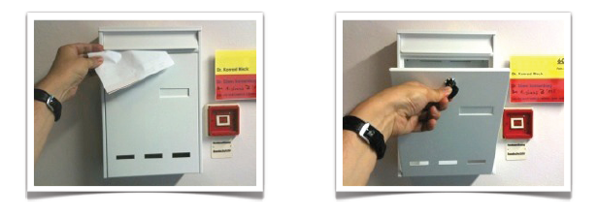
Asymmetric Keys
Solution: Two types of keys
public key pk (K+) = enables encryption but no decryption
Private/secret key sk (K–) = used for decryption only
Hard to deduce secret from public key
... similar to a classic mailbox

Slide 25
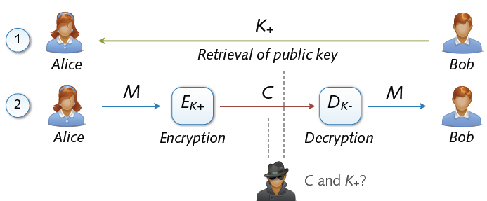
Asymmetric Cryptosystem
Asymmetric cryptosystems
Asymmetric encryption and decryption
K+ (pk) = public key of Bob K– (sk) = secret key of Bob
No secure key exchange necessary

Slide 26
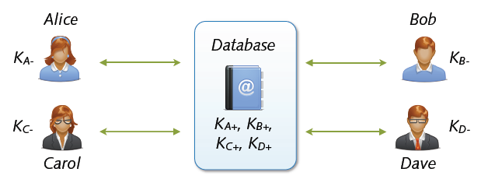
Key Exchange with Public Keys
Scalable communication with multiple parties
Linear number of exchanges: n parties → n public keys
Real-world systems with millions of keys (e.g. PGP)
... for the moment everything is fine

Slide 27
Public-Key Encryption Structure
A public-key encryption scheme has six ingredients
Plaintext: The readable message or data that is fed into the encryption algorithm as input.
Encryption Algorithm: Performs various transformations on the plaintext to produce ciphertext. The exact transformations depend on the public or private key used.
Public and Private Key: A pair of keys used for encryption and decryption. If one key is used for encryption, the other is used for decryption. Different keys produce different ciphertexts for the same message.
Ciphertext: The scrambled message produced as output by the encryption algorithm. It depends on the plaintext and the key used.
Decryption Algorithm: Accepts the ciphertext and the matching key to produce the original plaintext.

Slide 28
Public-Key Encryption Structure
The public key of the pair is made public for others to use, while the private key is known only to its owner.
A general-purpose public-key cryptographic algorithm relies on one key for encryption and a different but related key for decryption.
The essential steps are the following:
Each user generates a pair of keys to be used for the encryption and decryption of messages.
Each user places one of the two keys in a public register or other accessible file.
This is the public key.
The companion key is kept private.
(Figure 2.6a) each user maintains a collection of public keys obtained from others
If Bob wants to send a private message to Alice. Bob encrypts the message using Alice’s public key.
Alice receives the encrypted message. Alice decrypts it using her private key. Only Alice can decrypt the message because only she possesses her private key

Slide 29
Public-Key Encryption Structure → Application
Session setup (for now, only eavesdropping security)
Non-interactive applications: (e.g. Email)
Bob sends email to Alice encrypted using pk_{alice}
Note: Bob needs pk_{alice} (public key management)
Alice
pk
Bob
Generate (pk, sk)
choose random x
(e.g. 48 bytes)
E(pk, x)
x

Slide 30
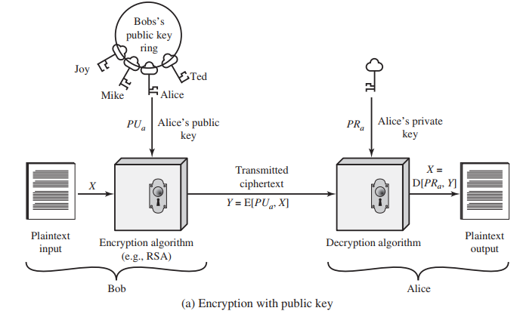
In (a), public key encryption ensures confidentiality because only the intended recipient (Alice) can decrypt the message using her private key.
directed toward providing confidentiality

Slide 31
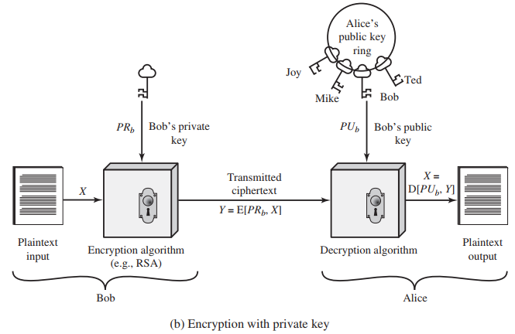
In (b), private key encryption provides authentication because the message decrypted with the public key confirms it was encrypted by the holder of the private key (Bob).
This method is often used in digital signatures to verify the sender's identity.
directed toward providing authentication and/or data integrity.

Slide 32
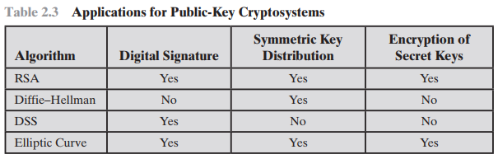

Slide 33
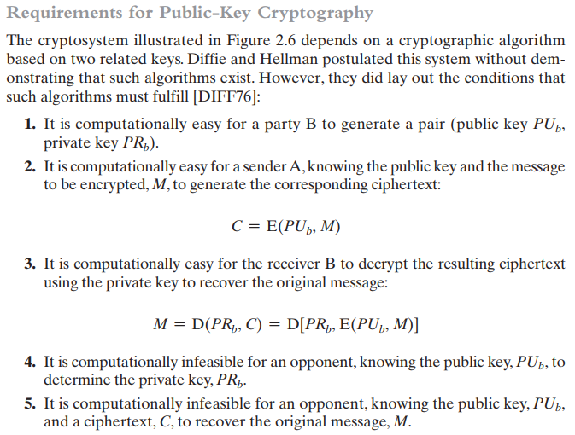

Slide 34
RSA is s invented by Rivest, Shamir and Adleman of MIT.
It is most widely used for secure data transmission.
RSA Algorithm is known as Public key Cryptography.
RSA is a block cipher where the plaintext and ciphertext are integers between 0 and n−1 for some n.
Key Size Considerations:
An early implementation of RSA used a public-key size (length of nnn) of 129 decimal digits, which is around 428 bits.
This result does not invalidate the use of RSA but suggests that larger key sizes are necessary.
Currently, a 1024-bit key size (approximately 300 decimal digits) is considered strong enough for most applications.

Slide 35
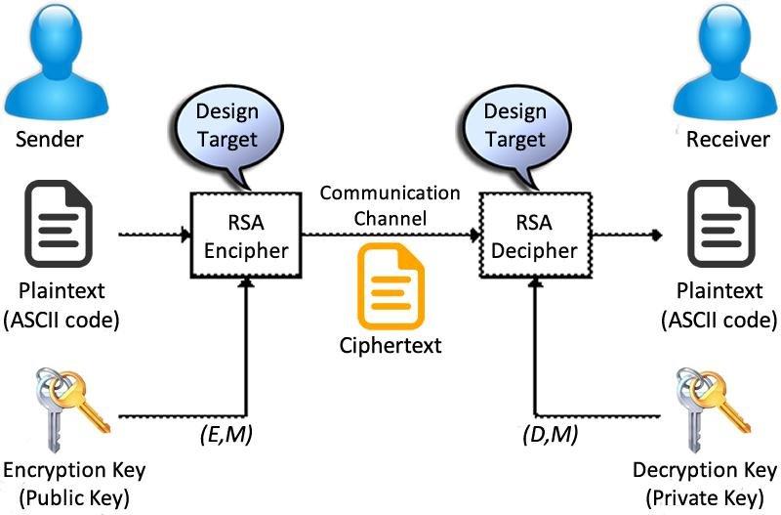
Facts and Conjectures:
Fact 1: Prime generation is easy. It’s straightforward to find a random prime number of a given size.
Fact 2: Multiplication is easy. Given two primes p and q, it's easy to compute their product, n=pq
Conjecture 3: Factoring is hard. Given such an n, it is believed to be difficult to recover the prime factors p and q.

Slide 36
RSA Steps:
Key Generation
Encryption
Decryption
Key Generation:
Choose random primes p, q (≈1024 bits)
compute n = p.q, n will be used as the modulus for both the public and private keys.
Compute Euler function ϕ(N) = (p-1)(q-1)
Choose random public key e with gcd (e, ϕ(N)) = 1
Compute private key demod ϕ(N) =1
This can be done using the Extended Euclidean Algorithm.
Public key = (e, n) , Private key = (d, n)

Slide 37
The RSA Algorithm Example
Choose p = 3 and q = 11
Compute n = p * q = 3 * 11 = 33
Compute φ(n) = (p - 1) * (q - 1) = 2 * 10 = 20
Choose e such that 1 < e < φ(n). Let e = 7
Compute a value for d such that (d * e) % φ(n) = 1. One solution is d = 3 [(3 * 7) % 20 = 1]
Public key is (e, n) => (7, 33)
Private key is (d, n) => (3, 33)
The encryption of m = 2 is c = 2⁷ % 33 = 29
The decryption of c = 29 is m = 29³ % 33 = 2

Slide 38
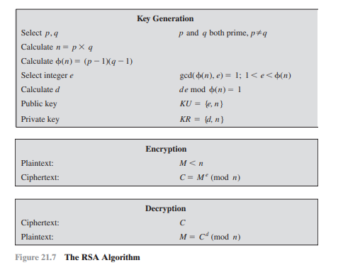
Encryption :
To send a secure message M, the sender converts the message into an integer m
The sender encrypts the message using the recipient's public key (e, n) with the formula:
Decryption :
The recipient decrypts the ciphertext using their private key (d, n) with the formula:

Slide 39
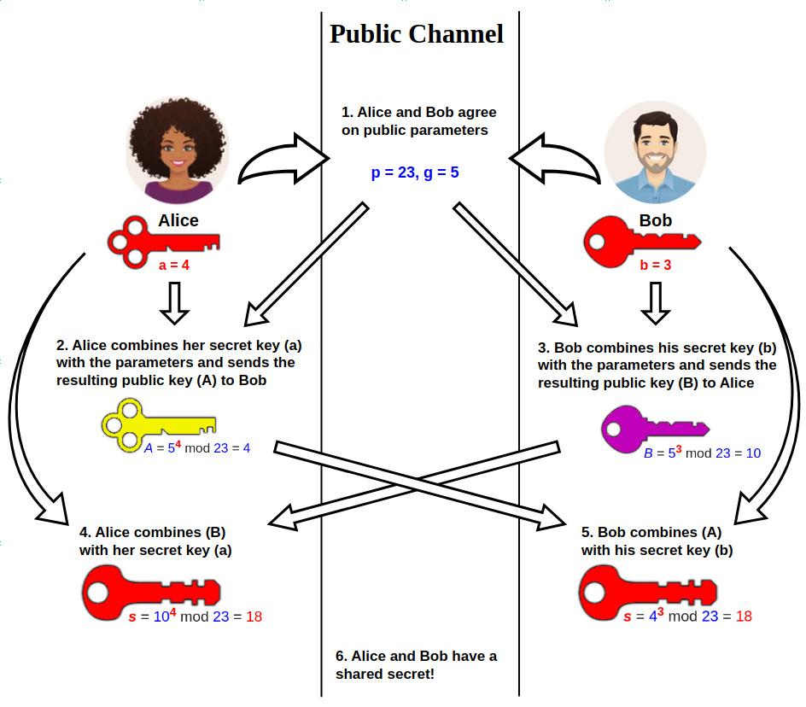
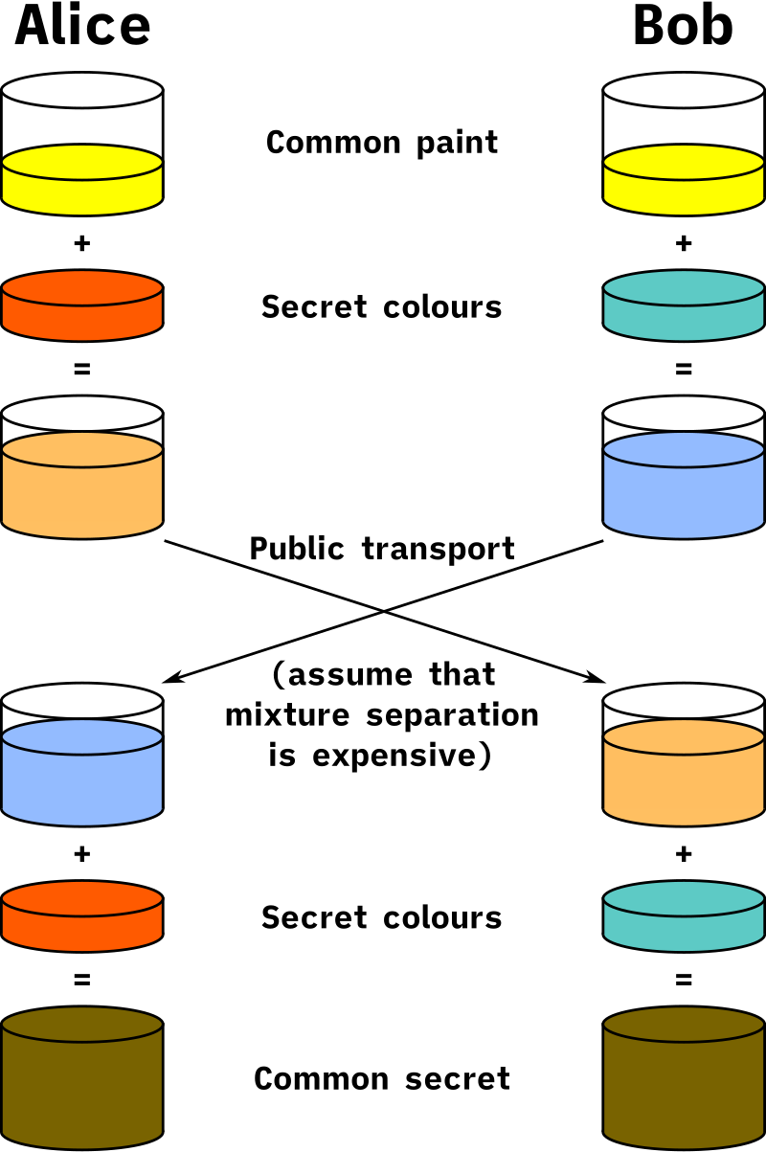
Diffie–Hellman key exchange
The Diffie-Hellman Key Exchange is a method used for securely exchanging cryptographic keys over a public channel.
It allows two parties, who have no prior knowledge of each other, to establish a shared secret key, which can then be used for encrypted communication.

Slide 40
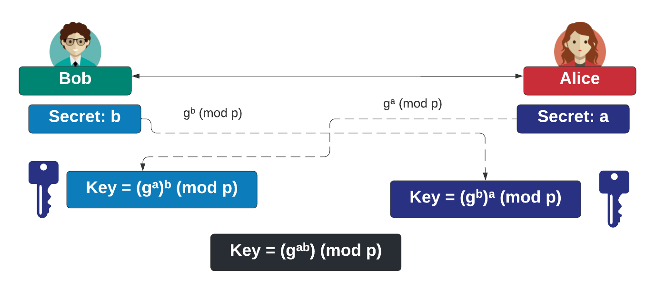
Diffie–Hellman key exchange
Bob creates a random value (b) and Alice also creates a random value (a).
Next Bob computes B=g^{b}(modp) and sends it to Alice.
Alice computes A=gª(modp) and sends this to Bob.
Bob raises the value of A to the power of b and takes (modp), and Alice raises B to the power of a and takes (modp).
In the end, they will have the same shared value: g^{ab}(modp).
Overall, p is the large prime number, and also known as the shared modulus between Bob and Alice.

